Slide 1

Agile Software Development
Setting Up an Agile Project
SoftUni Team
Technical Trainers
Software University
http://softuni.bg

Slide 2
Table of Contents
Homework Questions
Setting Up an Agile Project
Project Management Software

Slide 3
Have a Question?
sli.do #Agile-2021

Slide 4
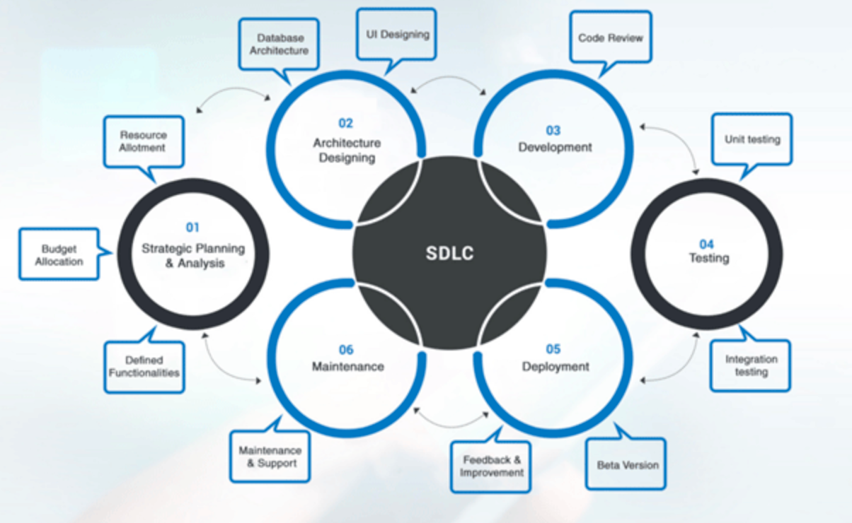
Refresher
The process of planning, creating, testing and deploying a software is called Software Development Life Cycle or SDLC.

Slide 5

Homework Questions?

Slide 6

Setting Up an Agile Project

Slide 7

Selecting a Project
Length of Time
Risks
Stakeholder involvement
Project vision and scope

Slide 8
Team Formation
Product Owner
Agile TL / Scrum Master
Development Team
Business Analyst
UI/UX
Customer (not really part of the team, but the important part of the process)

Slide 9
Best Practices
Coding Standards
(Peer) Code Review
Pair Programming
Test-driven Development (TDD)
Automated Tests
Continuous Integration and Continuous Delivery

Slide 10
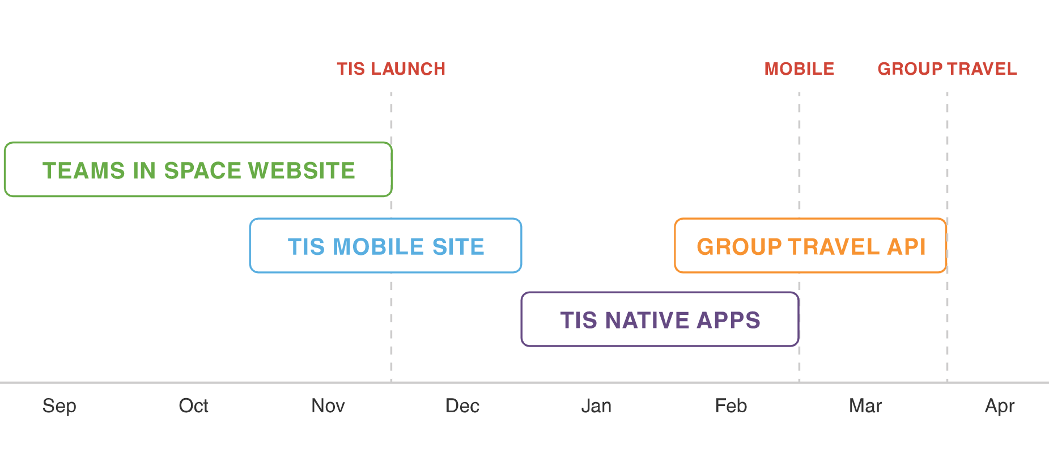
Planning - Roadmap
Building the roadmap
A product roadmap is a plan of action for how a product or solution will evolve over time. Product owners use roadmaps to outline future product functionality and when new features will be released. When used in agile development, a roadmap provides crucial context for the team's everyday work and should be responsive to shifts in the competitive landscape.

Slide 11
Planning - Release Plan
Built around short-term sprints with the goal of regularly and consistently releasing usable software
High-level timetable for each release
Feature prioritization by release

Slide 12
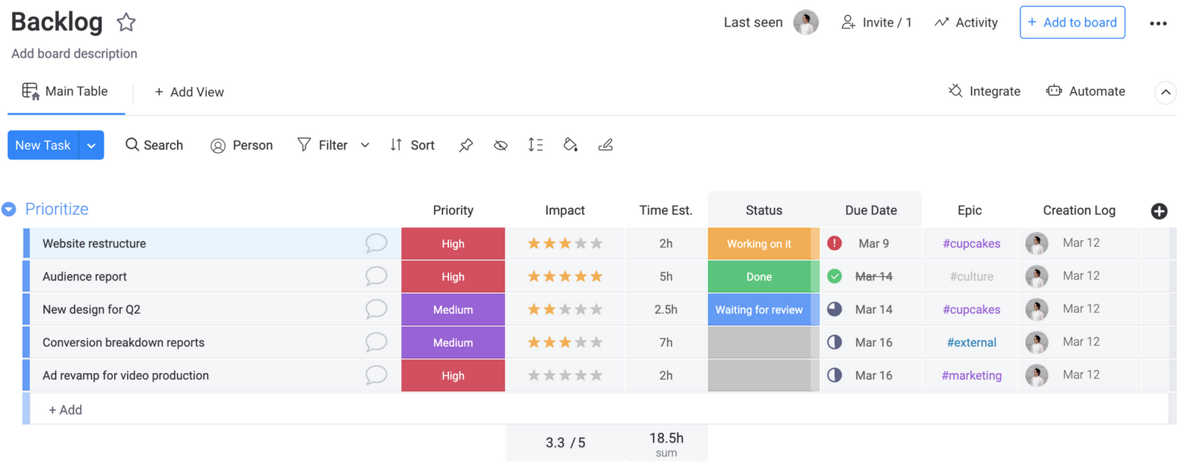
Planning
Agile project plan is divided into releases and iterations
User Stories
Acceptance Criteria

Slide 13
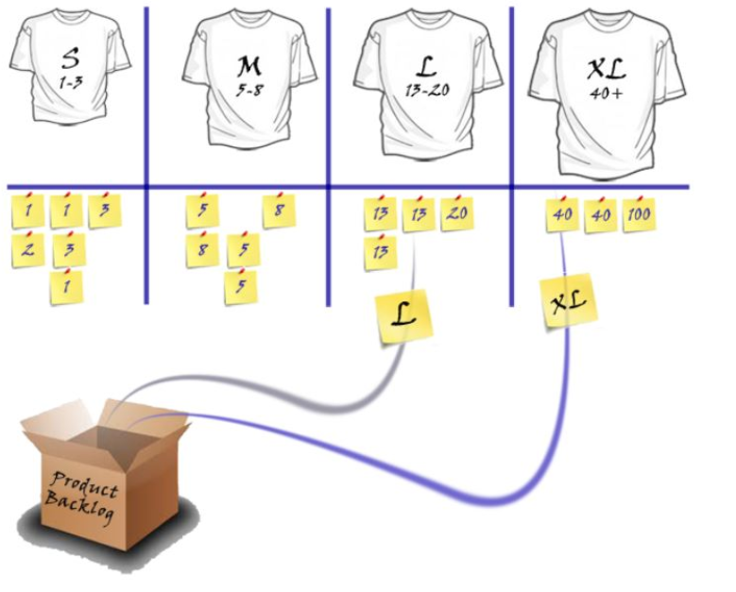
Estimation
Speed over accuracy
Collaborative techniques
Relative units
T-shirt size system: XS, S, M, L, XL, XXL

Slide 14
Iteration Zero
Size of the iterations
Operational risks
Process improvements

Slide 15
Iteration Planning
Macro to micro view
Iteration backlog
Iteration goals
Iteration tasks

Slide 16
Iteration Tasks
Create a task board
Assign tasks to team members
Clear definition
Timebox
Progress tracking

Slide 17
Evaluation and Success
Key elements of success of the sprint:
Stand Up
Effective Communication
Measurement
What did I do yesterday?
What will I do today?
Do I have any problems or concerns?

Slide 18
Interaction
Communication
Teamwork
Cooperation
“Individuals and interactions over processes and tools.”

Slide 19
Iteration Review and Demo
Work done during the iteration is discussed
Finished increment is shown to the customer or the stakeholders
Collecting feedback from everyone:
Achievements
Impediments
Challenges
Retrospective session:
What was done well?
What went wrong?
What to improve?

Slide 20

Project Management Software

Slide 21
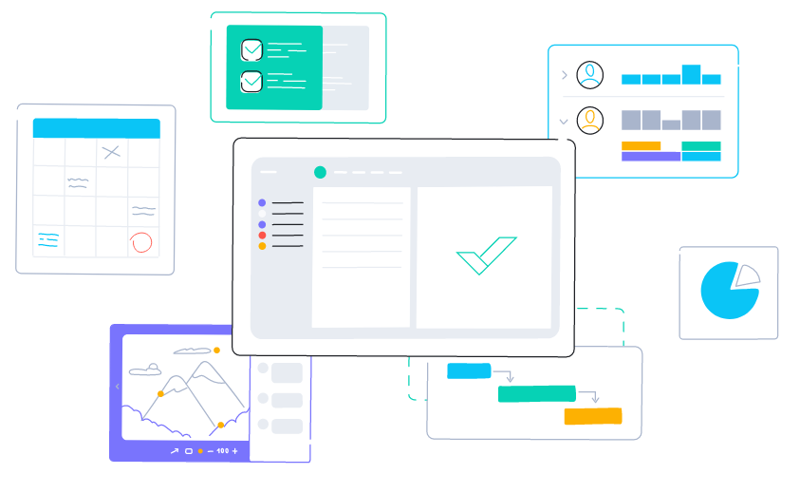
Project Management Software
Project planning
Project scheduling
Resource allocation and capacity planning
Budgeting and monitoring project costs
Project portfolio management
Business process management
Workflow management
Quality management
Storing and sharing documentation and project records
Creating and publishing project reports
Tracking the actual time spent on project tasks
Analyzing trends and forecasting

Slide 22
Real-time instant messaging tool
Allows people to communicate
Video chat
Meetings
Non-verbal communication
Most used:
Slack
Zoom
Teams

Slide 23
Knowledge base tool
Building a knowledgebase
Document processes
Record expertise or best practices to share
Information is accessible to all

Slide 24
File-sharing tool
Collaboration
Save, sync, and share files with your team
Most used tools:
Dropbox
OneDrive
Google Drive

Slide 25
Personal productivity tools
Avoid interruptions
Focus solely on work

Slide 26
Why project management software?
Easily create new projects and tasks from old files and templates
Modifications to existing projects and
Reports and dashboards visualizing project performance
Real-time progress
Project health overview
Alerting and notifications
Centralized learnings and documentation
Coordinate tasks and automate workflows

Slide 27
Project management software benefits
Centralization
Coordination
Communication

Slide 28
Selecting project management software
Will the team use it?
Can it be used across departments?
Support for transparency and clear communication
Flexibility
Custom reports
Ease and security for external communication
Integration

Slide 29
Key features
Real-time collaboration
Sharing and storing documents
Cost management
Reporting
Ease of use
Template creation
Warning flags
Scheduling
Time management
Resource allocation
Customization
Controls and governance
Integration capability
Unique calendars

Slide 30
Project management software investment
Growth
Interdependency
Efficiency

Slide 31
Homework
Research and create a detailed comparison of the three project management tools:
Jira
Asana
Trello
Focus on advantages, disadvantages and application

Slide 32

Summary
Setting Up an Agile Project
Project Management Software
Homework
Q&A
…
…
…

Slide 34













SoftUni Diamond Partners

Slide 35




SoftUni Organizational Partners

Slide 36





Trainings @ Software University (SoftUni)
Software University – High-Quality Education, Profession and Job for Software Developers
softuni.bg
Software University Foundation
http://softuni.foundation/
Software University @ Facebook
facebook.com/SoftwareUniversity
Software University Forums
forum.softuni.bg

